Slide 1




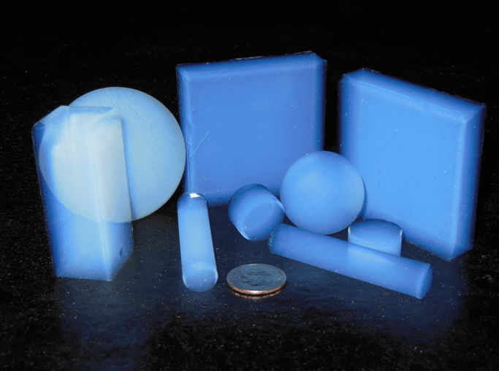
Mechanical
Electronics Box Insulation
04/09/21
Tanmay & Polina
Aerogel
Most likely in conjunction with MLI (see Polina’s slides)
Lightweight, great insulator
Need something beyond just reflecting heat
Enhances heat retention inside box
Procurement: Caltech MS labs, JPL extras, NASA license
Already used in spaceflight
carbon-based or silica or metal oxides (outgassing?)
Thin film aerogel by NASA is promising
NASA Link

Slide 2
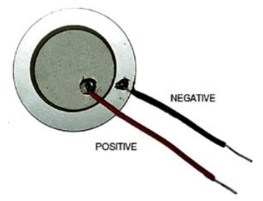
Mechanical
Electronics Box Touch Sensor
04/09/21
Tanmay Gupta
Astronaut Touch Controls
Button could get “clogged” by dust
adds a point of dust ingress and point of failure
Use a touch based alternative
3 alternatives: Capacitive sensor, Piezoelectric Transducer, Strain Gauge
Piezoelectric Transducer
Best option given enclosure
generate signal/voltage change based on pressure
Adjust sensitivity to require reasonable astronaut tap pressure
Coupled with LED for status information
Already used in rockets
Cost-effective

